Slide 1
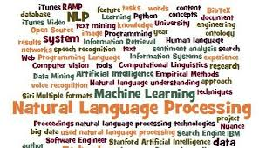
Research directions in NLP and Social Media Text Analytics
Anand Kumar M, CEN
Amrita Vishwa Vidyapeetham

Slide 2
Road Map
Social media text-Challenges
Recent Text Analytics
Research Progress / Applications
Technology and Tools

Slide 3
Natural language and NLP
Natural Language
Refers to the language spoken by people, e.g. English, Hindi, as opposed to artificial languages, like C++, Java, etc.
Natural Language Processing
Natural language processing (NLP) is a field of computer science, artificial intelligence, and linguistics concerned with the interactions between computers and human (natural) languages.
human–computer interaction.

Slide 4
Natural language and NLP
Ultimate goal
– To build computer systems that perform as well at using natural language as humans do(making computers as intelligent as people) .
Immediate goal
– To build computer systems that can process text and speech more intelligently.
Enable Human-Machine Communication
Improving Human-Human communication
Processing of Text or Speech

Slide 5
Natural language and NLP
Ultimate goal
– To build computer systems that perform as well at using natural language as humans do(making computers as intelligent as people) .
Immediate goal
– To build computer systems that can process text and speech more intelligently.
Enable Human-Machine Communication
Improving Human-Human communication
Processing of Text or Speech
What is the difference b/w Natural Language and Programming Language ?

Slide 6
Ambiguity
Phonetic
[raIt] = write, right, rite
Lexical
book= noun, verb
Structural
I saw the man with the telescope
Semantic
dish = physical plate, menu item
All of these make NLP difficult

Slide 7
Social media Text
Text mining = Methods for extracting useful information from large and often unstructured collections of texts.
Structured
Loadable into spreadsheet
Data is uniform and consistent
Unstructured
MS word, HTML, PDF and PPT and multimedia content.
Often converted into XML (Semi structured)
Variable length, Sparse and inconsistent

Slide 8
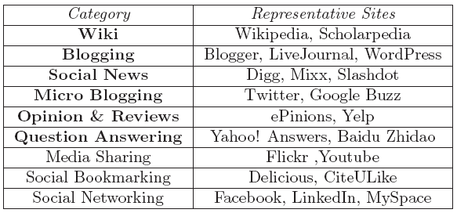
Types of Social Media

Slide 9
Why ?
80% of the information of an organization is stored in unstructured textual format.
Market trend is based on the content of the online news articles, sentiments, and events

Slide 10
Challenges in Social Media Text
Social Media Texts are about Products or different persons
Informal and Noisy
lack of sufficient context
Misspellings, Abbreviations and spelling variations
Good Night
Gud nite, gud nit, Good 9t, gud 9t, gn.
Performance of the present standard language processing tools is severely affected on Social Media Text.

Slide 11
Variety of Text

Slide 12
Recent Text Analytics
Text Classification
Information Extraction
Sentiment Analysis
Social Media Text Analytics

Slide 13
Research Progress – Applications Text Classification and Clustering
Text Classification and Clustering
Document /Domain Classification
Topic Identification and modeling
Spam Detection (Mail, SMS etc)
Journal Identification
Authorship identification
Age/gender identification

Slide 14
Sentiment Analysis
Sentiment Analysis
Word, Sentence and Documents
2 point, 3 point and 5 point Scale
Reviews Classification (movies, products and restaurants)
News Comments Classification.
Aspect based Sentiment analysis

Slide 15
Subjective vs. Objective Sentences
Subjectivity classification : Subjective or objective.
•Objective: e.g., I bought an iPhone a few days ago.
•Subjective: e.g., It is such a nice phone.
Sentiment classification: For subjective sentences or clauses, classify positive or negative polarity.
Positive: It is such a nice phone.
Negative: My phone broke in the second day.
Aspect based Sentiment
(Phone …. Positive)
(Touchscreen …. Positive)
(Voice Quality….. Positive)
(Battery Life ….. Negative)
(Price….. Negative)

Slide 16
Information Extraction
Data crawling/extraction
Sense Disambiguation
Entity extraction and Recognition
Paraphrase detection
Event Detection
Question answering

Slide 17
Paraphrase detection
Paraphrase can be defined as “the same meaning of a sentence is expressed in another sentence using different words”.
Quora, Yahoo answers etc.. /chat bots
nlp.amrita.edu/dpil_cen

Slide 18
Social Media Text Analytics
Entity extraction from Social media text
Language Identification
Native Language Identification
Author Identification
Author Profiling
Stance Detection

Slide 19
Named Entity Recognition
Identify entities in text and classify them into a predefined set of categories of interest.
Person, Place, Organization

Slide 20
Author Profiling
This helps in identifying aspects such as gender, age, demographics , native language, or personality type.
Author profiling is a problem of growing importance in applications in forensics, security, and marketing

Slide 21
Stance Detection
Stance detection is the task of automatically determining from text whether the author of the text is in favor of, against, or neutral towards a proposition or target.
The target may be a person, an organization, a government policy, a movement, a product, etc.
S. no. | Tamil-English
1 | Jayalalitha’s demise
2 | Demonetization
3 | Jallikatu
4 | OPS
5 | Swathi’s murder

Slide 23
Other Significant Tasks
Recommendation Systems (Books, News, Products and webpages etc)
Predictive and Trend analysis
Emerging Event Detection
Automated ad placement
Data visualization (word cloud)
Image and video annotations

Slide 24
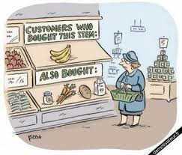
Recommender Systems
Systems for recommending items (e.g. books, movies, web pages, newsgroup messages) to users based on examples of their preferences.
Many websites provide recommendations (e.g. Amazon, Flip kart etc).
Recommender Systems have
been shown to substantially
increase sales at on-line stores.

Slide 25
Sentence descriptions from images
"construction worker in orange safety vest is working on road."
http://cs.stanford.edu/people/karpathy/deepimagesent/

Slide 26
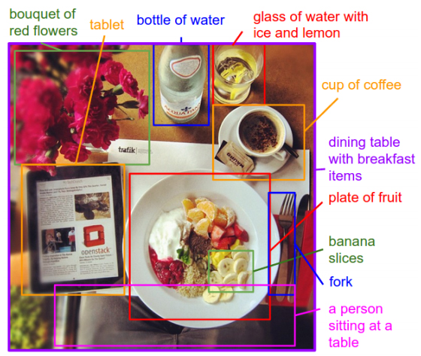
Visual-Semantic Alignments
http://cs.stanford.edu/people/karpathy/deepimagesent/

Slide 27
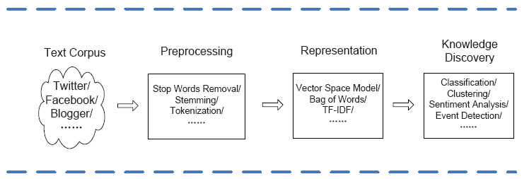
Text analytics frame work

Slide 28
Proposed Task
September 2017
Native Language Identification in Indian Languages. (Co-joined with Paolo Rosso , Universitat Politècnica de València, Spain)

Slide 29
Conclusion
NLP helps to improve the performance of Text Analytics
Good number Tamil Social media Content is available in Web.
Handling the mixed scripts and spelling errors.
Easy to involve the young generation in Tamil Language processing research.

Slide 30
m_anandkumar@cb.amrita.edu Thank you

